Slide 1
Cyber Threat Hunting
101
Beyond the Alerts
Presented by
K A I N U
Notes:
Welcome to Blue Team Village’s Project Obsidian : An Introduction

Slide 2
What Will We Learn?
What Threat Hunting Is
Why We Should Threat Hunt
How Threat Intel Feeds Threat Hunting
How Threat Hunting Leads To DFIR
Demo: M365 Threat Hunting
Additional learning resources

Slide 3

What is Cyber Threat Hunting? What does ChatGPT say?
“Cyber Threat Hunting is the proactive search for hidden threats in an organization's environment, even when there are no obvious signs of an attack.”
“Instead of waiting for alerts or alarms, threat hunters actively seek out signs of compromise, malware, insider threats, or unauthorized access before they cause damage.”
– ChatGPT
Notes:
It is proactive vs incident response is reactive

Slide 4
What is Cyber Threat Hunting? What does KAINU tell folks?
“To see what is hidden, one must understand what should be seen.
For evil rarely enters loudly; it wears the mask of the familiar. Only by knowing what is normal can we recognize when the mask begins to fade”
– KAINU
Notes:
Trust but verify
Know normal to find evil

Slide 5
Why should we Threat Hunt?
Gaps in traditional security tools
Mean time to detect (MTTD) is often too long
Threat actor sophistication and living-off-the-land techniques
Compliance and industry best practices
Notes:
I have seen current traditional edrs miss several entry level pentesting exercises and mssp / soc teams could take hours to respond to an alert.

Slide 6





The Fusion Wheel: Integrating Security Functions
Threat Intelligence (TI)
Threat Hunting (TH)
Informs detection rules, enriches context, and feeds hunting and incident response efforts. Draws from OSINT, commercial feeds, and internal telemetry.
Detects unknown threats by establishing baselines and identifying anomalies ("knowing normal to find evil"). Leverages Sigma/YARA rules, Chainsaw log analysis, and MFT parsing.
Incident Response (IR)
Reverse Engineering (RE)
Executes playbooks based on identified threats, driven by both TI and Hunting outcomes. Performs investigations on impacted hosts to extract evidence.
Deconstructs malware artifacts, binaries, and scripts to feed intelligence and detection development. Supports incident response and root cause analysis.
Digital Forensics (DF)
Performs in-depth investigations on impacted hosts, extracting evidence to support incident response and reverse engineering efforts.
AI-powered automation amplifies each function—from extracting indicators to suggesting hunting hypotheses, accelerating malware analysis, and predicting attacker movements through behavioral modeling.
When these disciplines collaborate continuously rather than operate in silos, defensive capabilities mature exponentially, creating a force multiplier effect against sophisticated threats.

Slide 7
Methods of Threat Hunting
Hypothesis-driven
(MITRE ATT&CK, threat intel, TTPs)
Data-driven (anomalies, baselining)
IOC-driven (hashes, domains, IPs)

Slide 8

Example Hypotheses
What if a user is accessing files at odd hours from a foreign IP?
What if there are signs of
credential stuffing against our VPN?

Slide 9
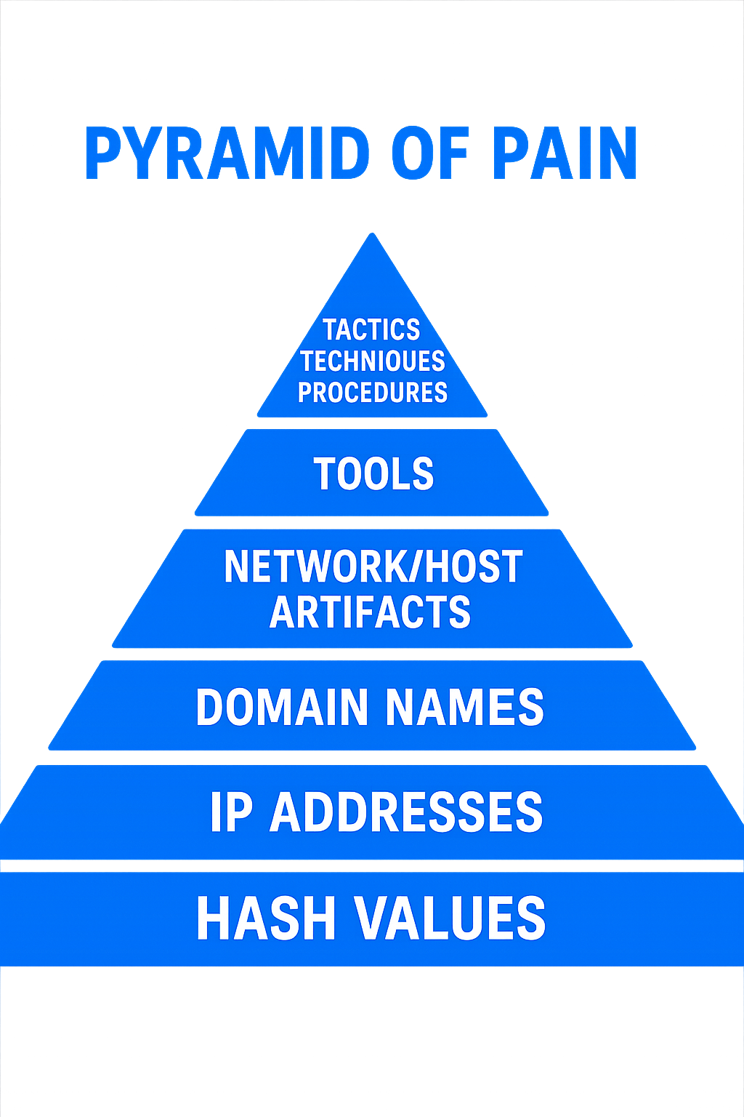
*Created by David J. Bianco
Notes:
Add creator

Slide 10
How Does Threat Intel Feed Threat Hunting?
Threat Intelligence provides insight into potential attack vectors and enhances threat hunting efforts by identifying emerging threats or areas within your environment that may be targeted.

Slide 11


What is the Difference between Threat Hunting and DFIR?
Think of Threat Hunting as the patrol that looks for signs of danger before anything goes wrong.
DFIR is the fire department that comes in after the alarm has gone off.

Slide 12

Where Can We Hunt?
Host logs (Sysmon, Windows Event Logs)
Network telemetry (PCAPs, DNS, NetFlow)
Cloud logs (Azure, AWS, M365)
Identity and access logs
And many more…

Slide 13
You Don’t need to be a senior analyst to start hunting. You just need 3 things:
Curiosity
Persistence
Hypothesis Thinking

Slide 14
Curiosity
Why is this happening?
What should this system be doing?
What would I do if I were an attacker?

Slide 15
Persistence
You won’t always find something, that’s normal
Every hunt improves your understanding of the environment.
Keep at it. Learning the weird stuff is how you become dangerous, in a good way.

Slide 16
Hypothesis Thinking
Start with simple questions:
Are users logging in at weird times?
Why is PowerShell running on this server?
Then try to prove or disprove it using the logs or tools you have.

Slide 17
LET US HUNT.

Slide 19
Additional Learning Resources

Slide 20


Project Obsidian GitHub
Other 101 Sessions provided by the BlueTeam Village Project Obsidian Group:
https://github.com/blueteamvillage/Project-Obsidian-DC33

Slide 21
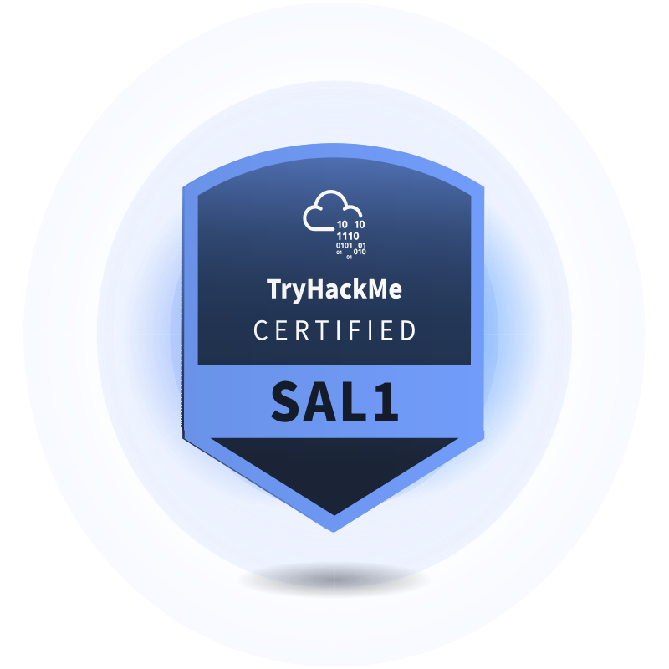

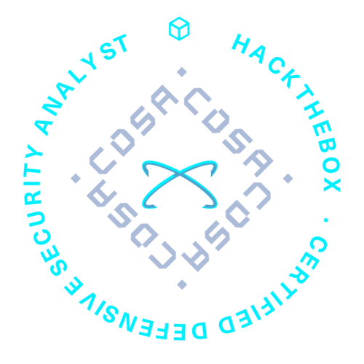

Platforms, Courses and Certs
The following courses can help on your
Threat Hunting journey.
Blue Team Labs Online - CTF style exercises
CyberDefenders - CTF style exercises
TryHackMe - Cyber Defense Learning Path - SAL1 Cert
HackTheBox Academy - SOC Analyst Pathway – CDSA Cert
HackTheBox Labs - CTF style exercises
OFFSEC – TH200 - OSTH cert
INE - eCTHP

Slide 22

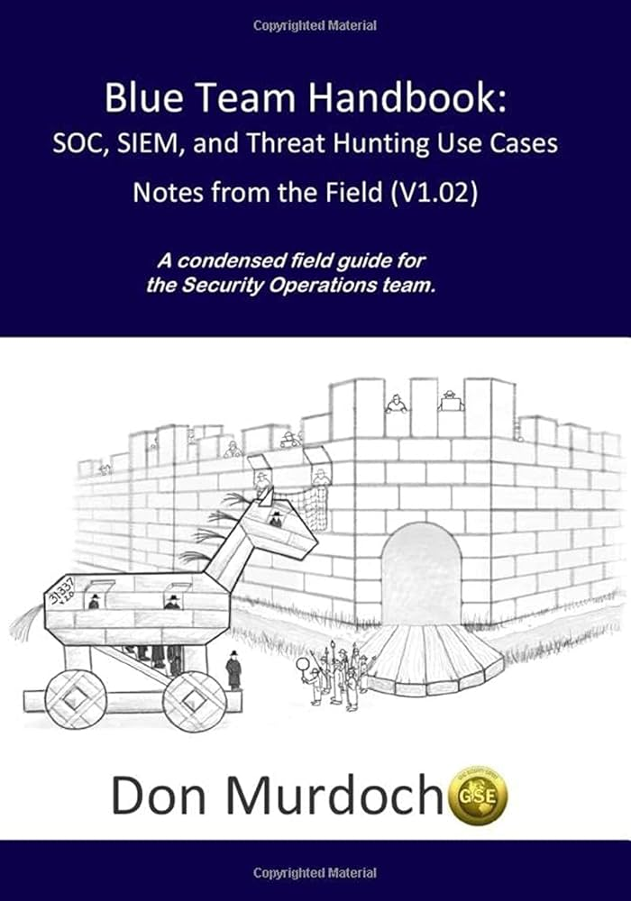
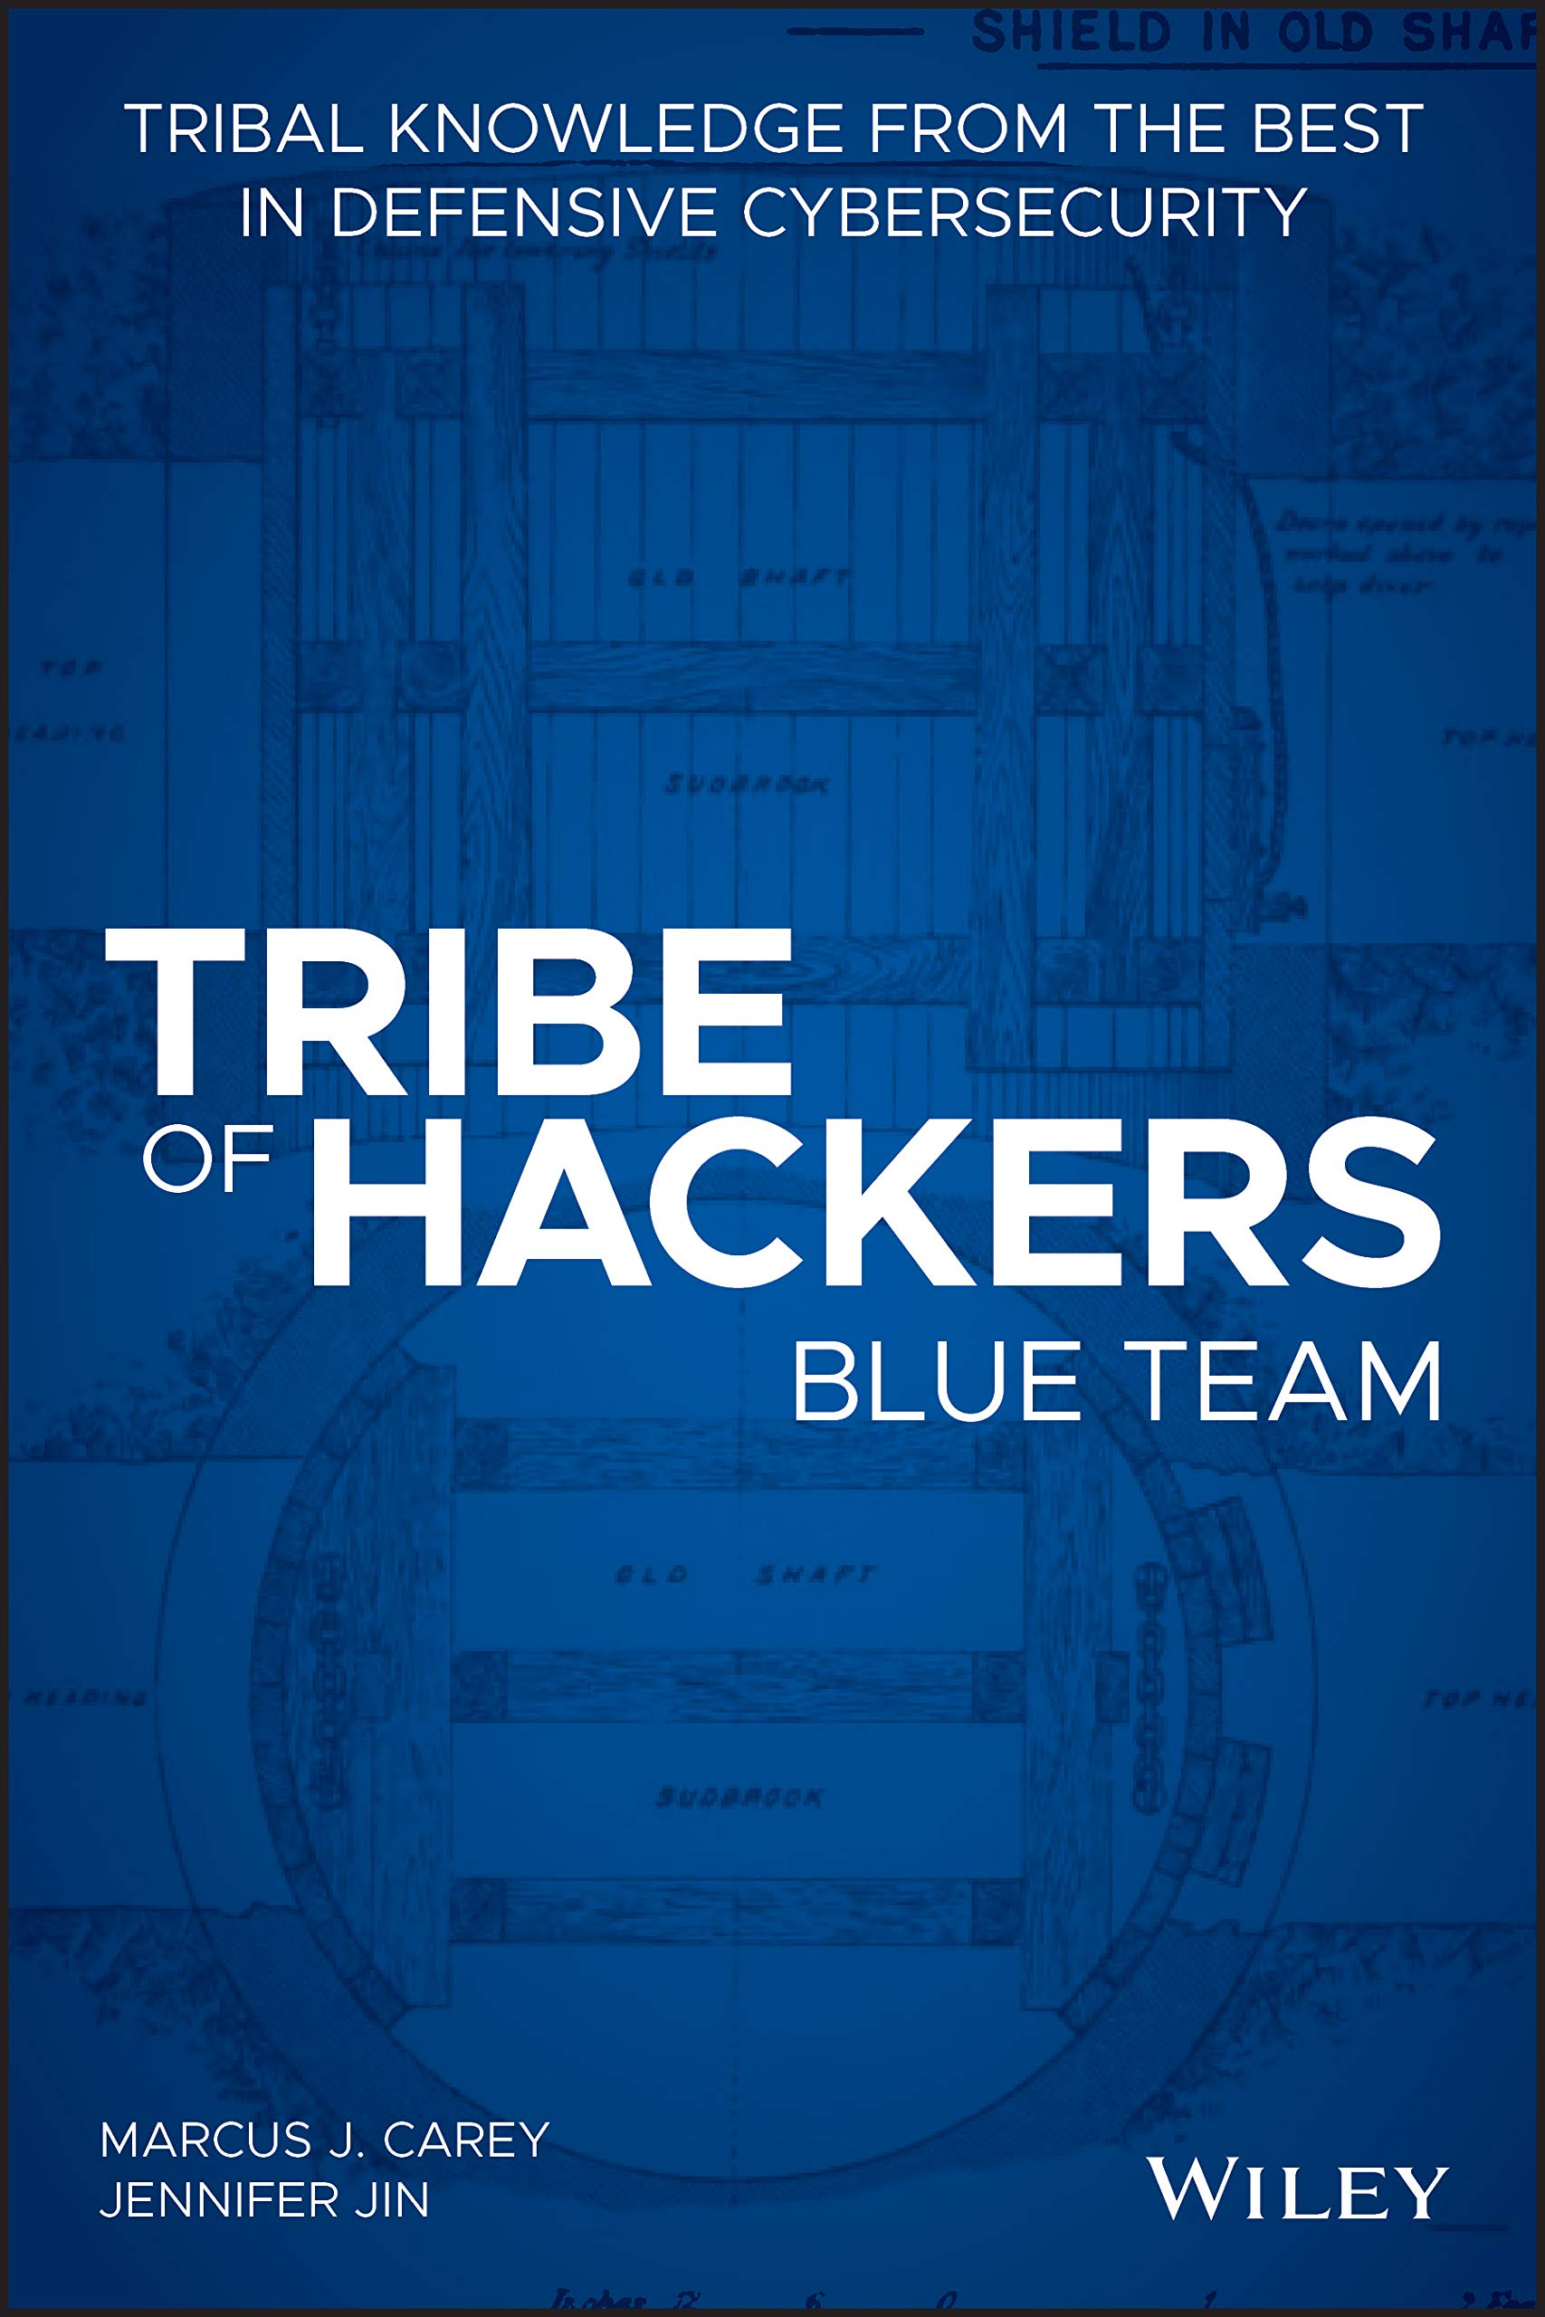
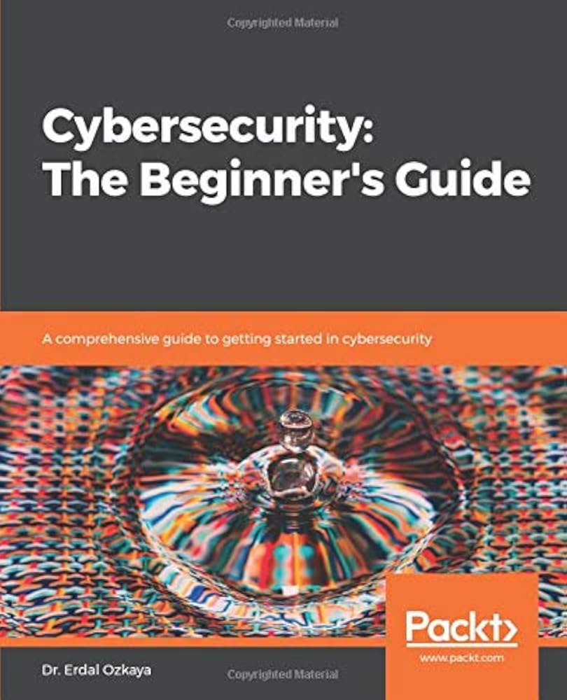
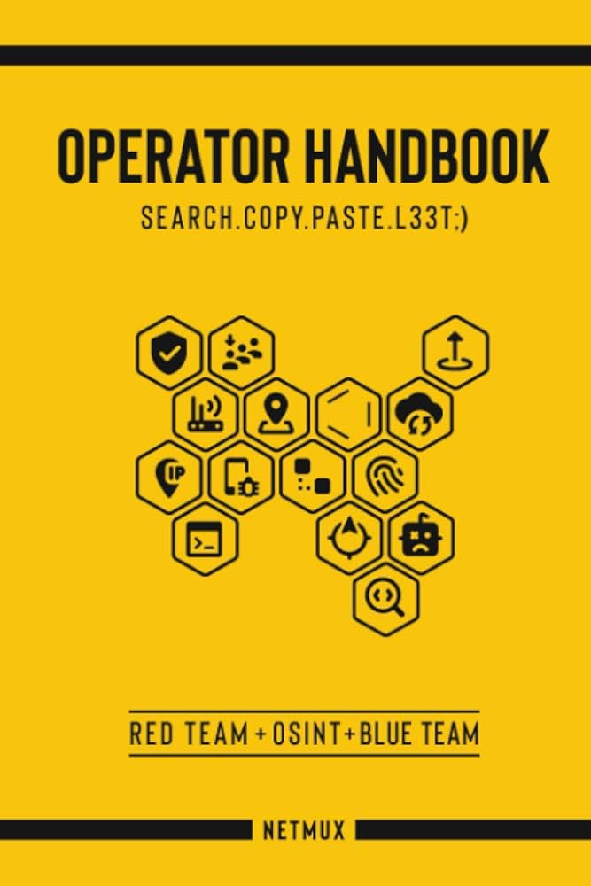
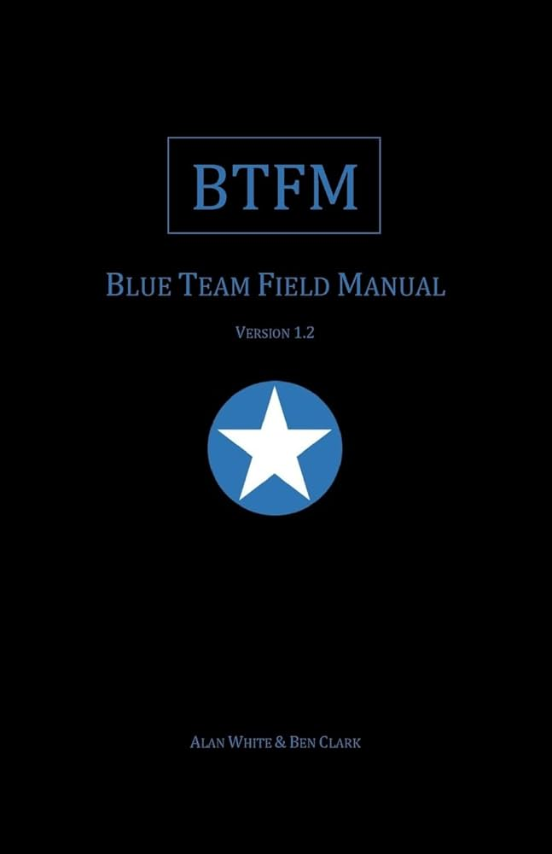
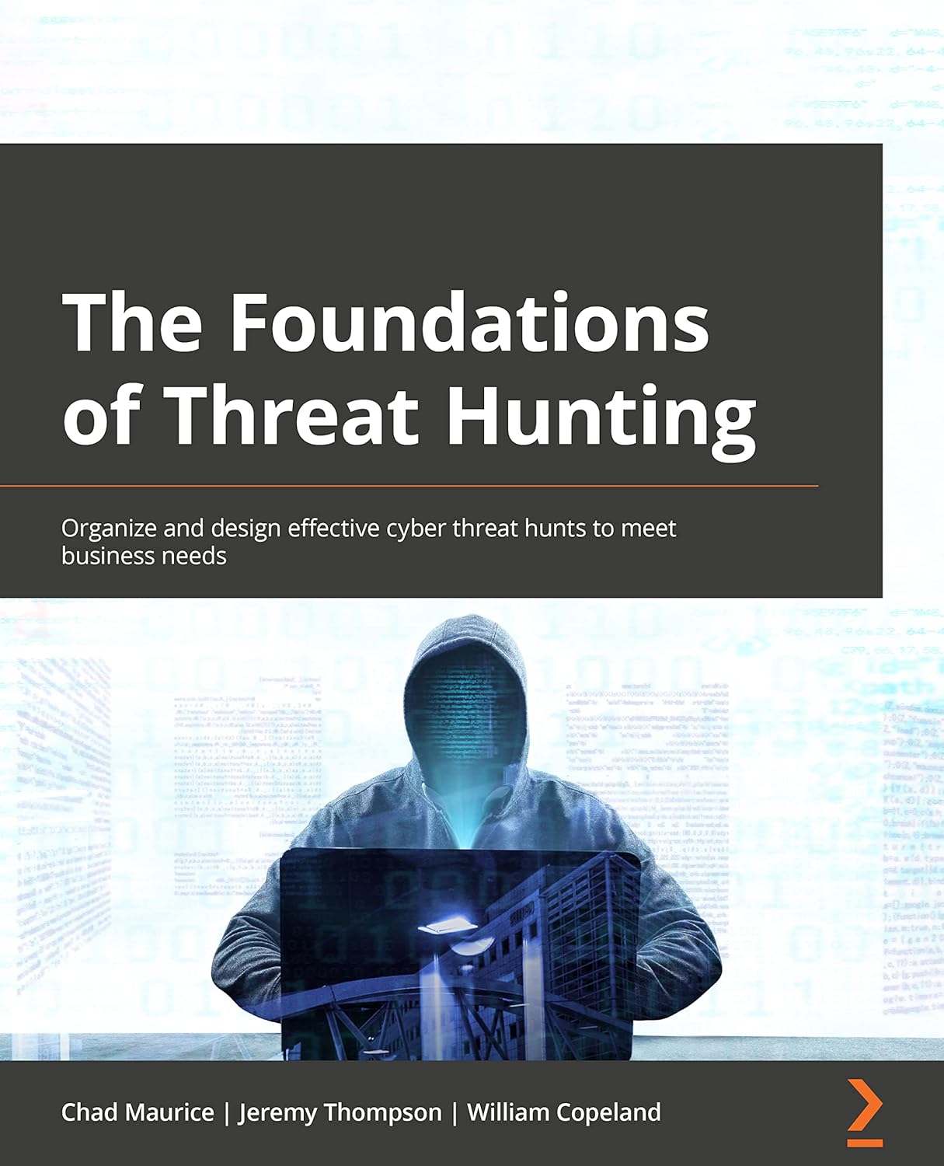
Books
Blue Team Handbook – Don Murdoch
Tribe of Hackers: Blue Team – Marcus J. Carey & Jennifer Jin
Cybersecurity: The Beginner's Guide – Dr. Erdal Ozkaya
Operator Handbook – Joshua Picolet
Blue Team Field Manual – Alan White & Ben Clark
The Foundations of Threat Hunting – Chad Maurice, Jeremy Thompson, William Copeland

Slide 23
Blogs and Git Repos
https://blog.openthreatresearch.com/
https://github.com/OTRF/ThreatHunter-Playbook
https://holdmybeersecurity.com
https://github.com/okhosting/awesome-cyber-security
https://training.dfirdiva.com/

